Slide 1
Russ Porter, CLU, ChFC, AEP

Slide 2
Life Insurance in the 2023 Estate Plan Life insurance isn’t for the people who die. It’s for the people* who live.
* Spouse, family, trust, charitable organization, business partners or associates

Slide 3
Today we will review varies components of life insurance forms and insuring organizations as well as the use of life insurance.
As an estate plan tool, life insurance establishes or funds an estate.
Generally, death benefits are paid free of ordinary tax but may affect estate tax.
When the estate tax exclusion was lower, it was common to use life insurance to pay estate taxes.
While this use has somewhat changed, but has not gone away, an understanding of the use of life insurance is still important for the financial advisor and estate planner.

Slide 4
a simple introduction to life insurance companies and types of policies
Stock companies
A stock insurance company is a corporation owned by its shareholders, and its objective is to make a profit for them. Policyholders do not directly share in the profits or losses of the company.
Examples are Lincoln Financial, Prudential and Transamerica.
Mutual and Mutual Holding companies
A mutual insurance company is an insurance company that is owned by participating policyholders. Profits that a Mutual insurance company earns are returned to members as dividends or a reduction in premiums.
Large mutual insurers in the U.S. include Northwestern Mutual, Guardian Life, Penn Mutual, and Mutual of Omaha.

Slide 5
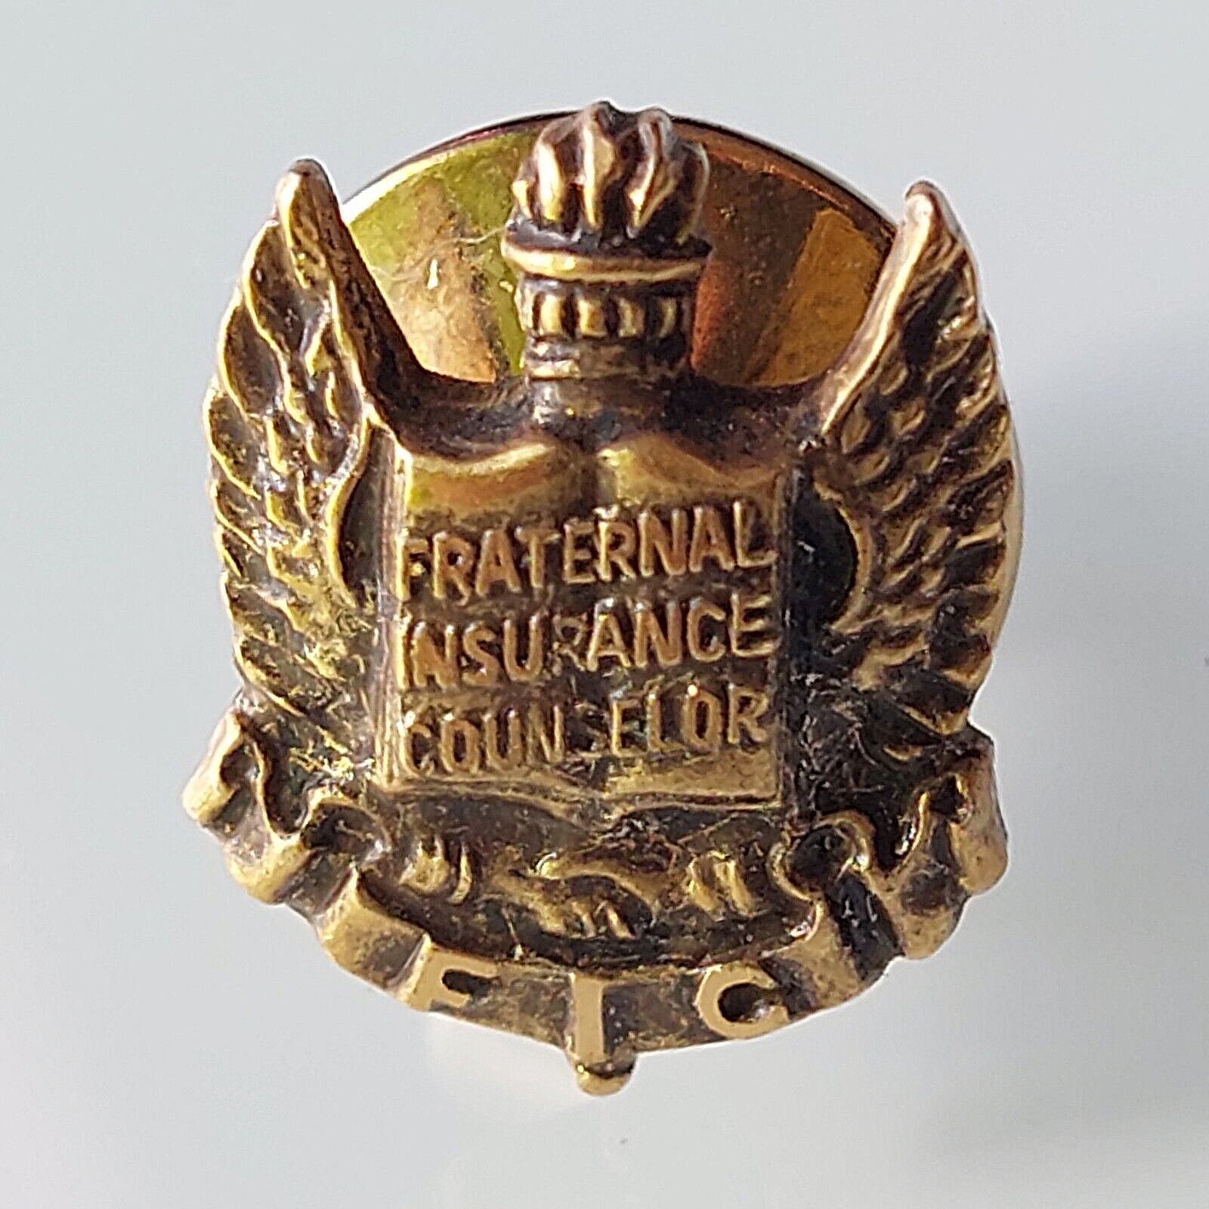
a simple introduction to life insurance companies and types of policies
Fraternal and association companies
Much like mutual companies, policies from Knights of Columbus and Farm Bureau are sponsored by a membership organization and profits benefit the policy holder and the organization. Some policies will require membership to buy coverage.
Reinsurance companies
They are usually stock or private companies who will work with life insurance companies to manage specific or high-risk needs.
The issuing company will have its name on the policy, but a reinsurance company may have issued a separate policy to the named company for the specific risk.

Slide 6
a simple introduction to life insurance companies and types of policies
State regulated
State division or department of insurance supervises, review, and govern practice of life insurance in the state borders.
Often organized with compacts between state departments of insurance. This allows for simpler adoption of policies that will be sold in different states.
In case of insolvent insurance companies, the department of insurance will negotiate the acquisition or liquidation of the company.
Insurance is backed by the Colorado Life and Health Insurance Protection Association. Limits apply to variable contracts. **
Federal law will define if a company is a stock or mutual company.
This Photo by Unknown Author is licensed under CC BY-NC-ND

Slide 7
Colorado Life and Health Insurance Protection Association.
**The Association provides coverage up to $300,000 for life insurance benefits; $100,000 in net cash surrender or withdrawal for life insurance; $100,000 for coverages not defined as disability, basic hospital, medical and surgical, or major medical insurance or long term care insurance; $300,000 for disability insurance; $300,000 for long term care insurance; $500,000 for basic hospital, medical and surgical, or major medical insurance; and $250,000 in present value of annuity benefits, including net cash surrender and net cash withdrawal values. The Association does not provide coverage for unallocated annuities.
With respect to each payee of a structured settlement annuity, $250,000 of present value annuity benefits, in the aggregate, including net cash surrender and net cash withdrawal values.
The Association cannot expend more than $300,000 in total, with respect to any one life, except that with respect to benefits for basic hospital, medical and surgical, or major medical insurance, the aggregate liability of the Association shall not exceed $500,000 with respect to any one individual.

Slide 8
a simple introduction to life insurance companies and types of policies
Ratings organizations
Five independent agencies—A.M. Best, Fitch, Moody’s and Standard & Poor’s—rate the financial strength of insurance companies. Each has its own rating scale, its own rating standards, its own population of rated companies, and its own distribution of companies across its scale.
The COMDEX rating system is a compilation of the top 4 ratings agencies/services that is reported as a whole number between 0 and 100.

Slide 9
Two types of life insurance policies; Term and Permanent
Term. (The simple life insurance.)
Individually owned term life insurance
Issued for a set number of years such as 10, 20 or 30 years or as an annual renewable term policy. It will pay a death benefit to the named beneficiary if the insured dies during the term of years outlined in the policy.
Coverage may be extended at a higher cost after the fixed number of years has expired.
Some offer guaranteed convertibility to a permanent policy during the term years and before a specific age such as age 70. The convertibility may be to a limited number of permanent policies with poorer interest options or higher cost assumptions or may be convertible to any policy offered by the company at the time conversion is requested.
Group term is issued as a certificate of coverage vs a policy under a group that is organized for a reason other than to buy insurance, such as an employer who offers such coverage as a benefit.

Slide 10
Two types of life insurance policies; Term and Permanent
Permanent Life Insurance
Whole Life
Universal Life

Slide 11
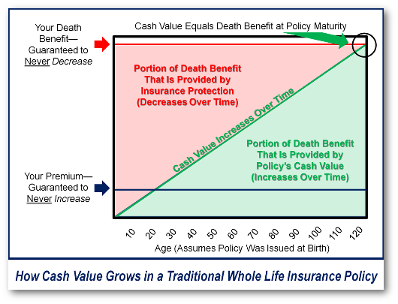
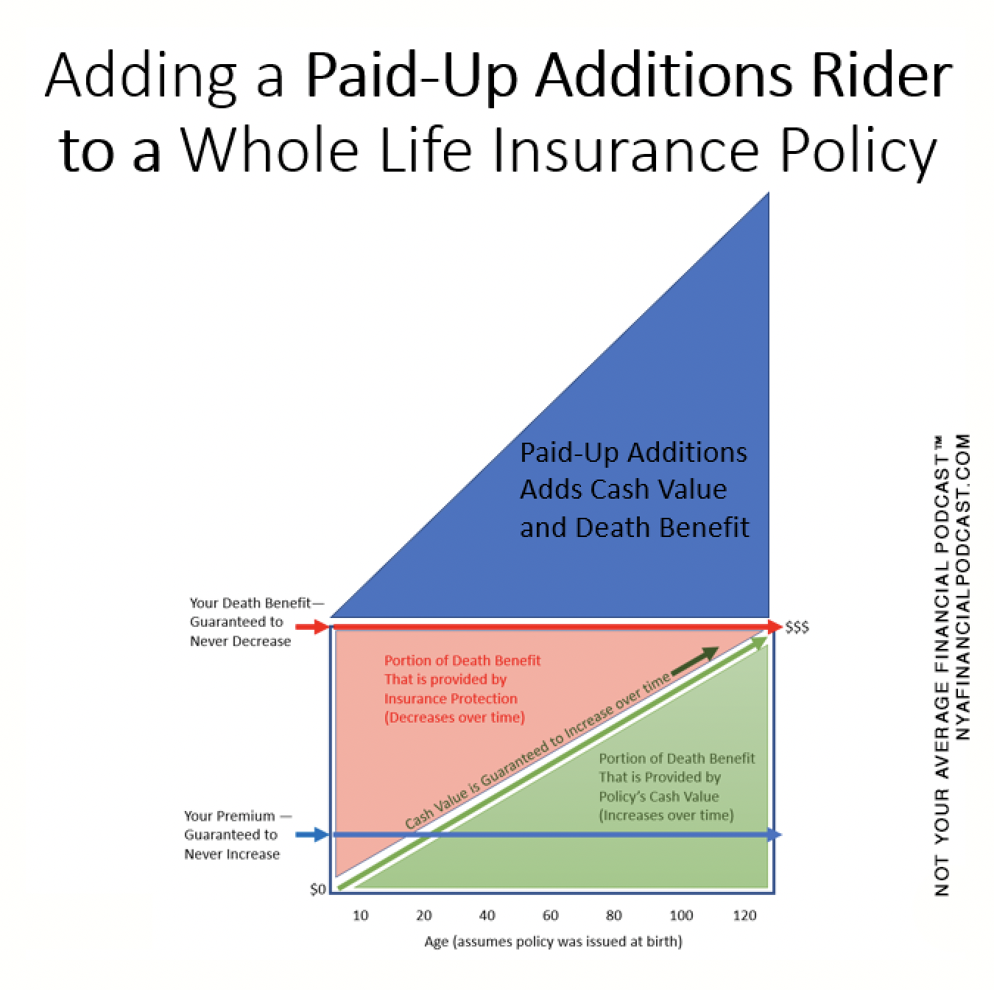
Whole Life Guaranteed & designed to last the “Whole Life” of the insured
Whole life insurance guarantees payment of a death benefit to beneficiaries in exchange for specifically scheduled premium.
Participating Whole Life includes a savings portion, called the “cash value,” alongside the death benefit.
In the savings component, interest may accumulate on a tax-deferred basis.
Growing cash value is an essential component of whole life insurance.
Can be bought with limited payment or single payment.
Dividends can buy additional insurance, pay part or all or premium or be paid in cash to the owner.

Slide 12
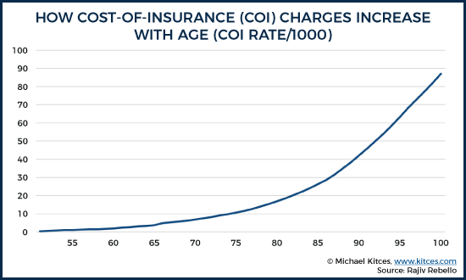
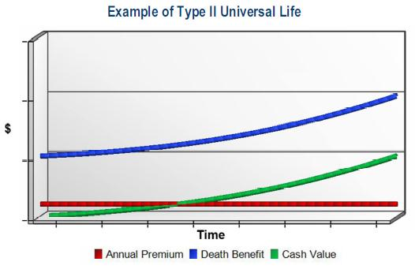
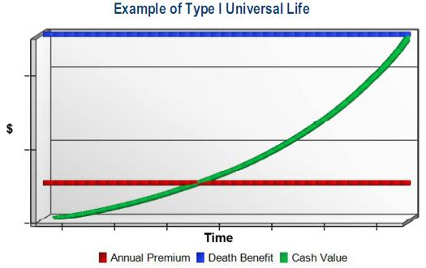
Universal Life (UL)
Created in late 1970s.
Cost of insurance increase over time.
Cash value is held in the policy and has an interest rate set by the insurance company with a minimum stated in the policy.
Assumed rate is used to project cost of premium over time.
If interest rate underperforms or premium underpaid additional premium will be needed, or the policy will lapse.
Policy can be issued to a specific age such as age 90, 100 or 110.

Slide 13
UL variations
Guaranteed Universal Life (GUL) is like UL with guaranteed death benefit rider that will keep the death benefit fixed even if the policy interest rate underperformed so long as the premium is paid according to schedule.
Index Universal Life (IUL) is like UL with interest rate linked to a standard index such as the S&P 500 with limits on gains and losses in the cash value of the policy.
Variable Universal Life (VUL) is like a UL, but cash value is invested in a separate (mutual fund) account. May or may not have limits on gains and losses like a GUL.

Slide 14
Permanent life insurance Cash value
Value grow tax deferred.
Can be accessed by withdrawal or loan
Death benefit can be set to level or adjust to include the cash value.
Whole life grows according the contact and is more predictable than UL.

Slide 15
Second to die permanent life insurance
Death benefit is paid at the death of the second insured.
Generally issued to married couple as part of the estate plan but may have other uses.
Most often issued as UL or GUL policy.

Slide 16
Use of life insurance in an estate plan
Every day need to provide money to establish an estate, pay bills, pay for a funeral, or provide a legacy.
Pay taxes:
There may be taxes due on an inheritance (Estate Tax or Inheritance Tax)
SECURE ACT 2.0 and the limited stretch IRA.
Business succession and continuation.
Buy/Sell
Key Person

Slide 17
Use of life insurance in an estate plan
Estate equalization for multiple heirs when property will not easily be divided.
Replenishing assets that may have been used by surviving parent or stepparent.
Fund care of special need child.
Used in philanthropic planning.
Long Term Care planning.

